Slide 1


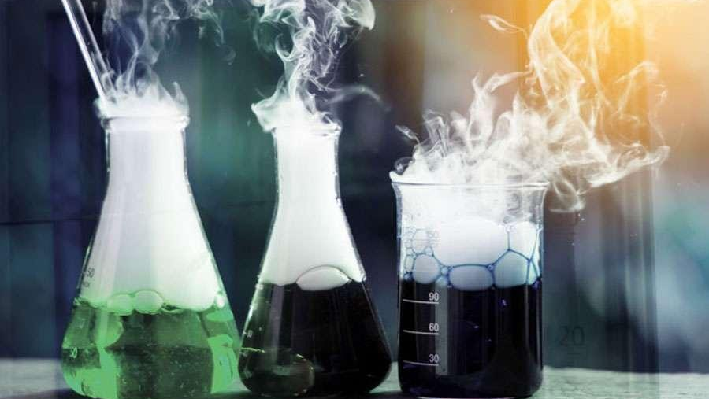
METABOLISM, ENZYME, AND ATP

Slide 2

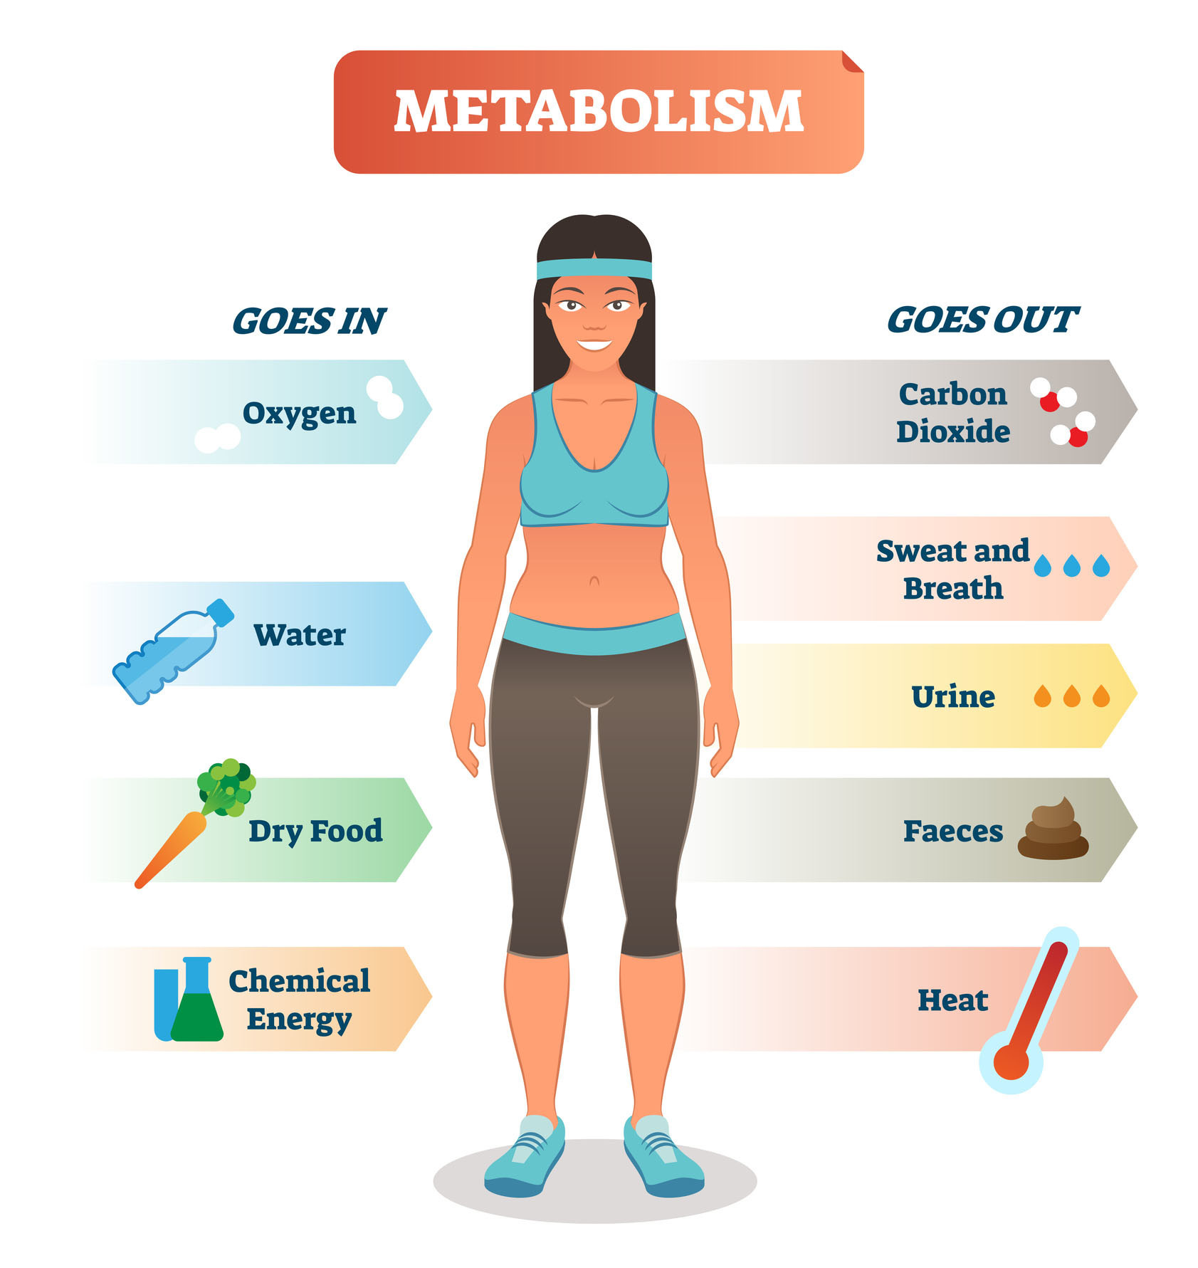
METABOLISM VS. CATABOLISM
Metabolism= a sum of all chemical reactions that occur within an organism
Catabolism= the process of breaking down complex molecules into simpler compounds

Slide 3
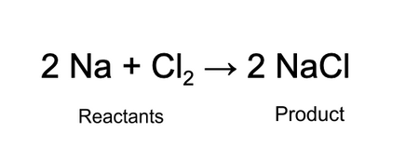
CHEMICAL REACTIONS
Process that changes one set of chemicals into another set of chemicals
Law of Conservation of Matter: matter cannot be created or destroyed
What happens to atoms during a chemical reaction?

Slide 4
CHEMICAL REACTIONS
Process that changes one set of chemicals into another set of chemicals
Law of Conservation of Matter: matter cannot be created or destroyed
What happens to atoms during a chemical reaction? Atoms are rearranged

Slide 5
Energy in Reactions
Chemical reactions store or release energy depending on the type of reaction
Exergonic Reaction: a release of energy occurs → the reactants will have more energy than the products
Endergonic Reaction: require the input of energy to occur → the products will have more energy than the reactants.

Slide 6
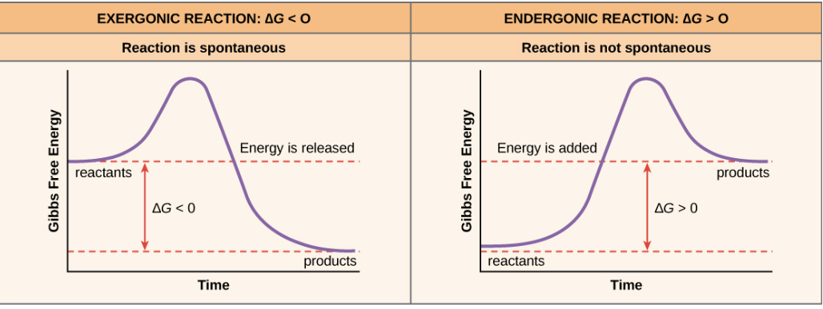
Energy Graphs
Which reaction would be anabolic and which reaction would be catabolic?

Slide 7
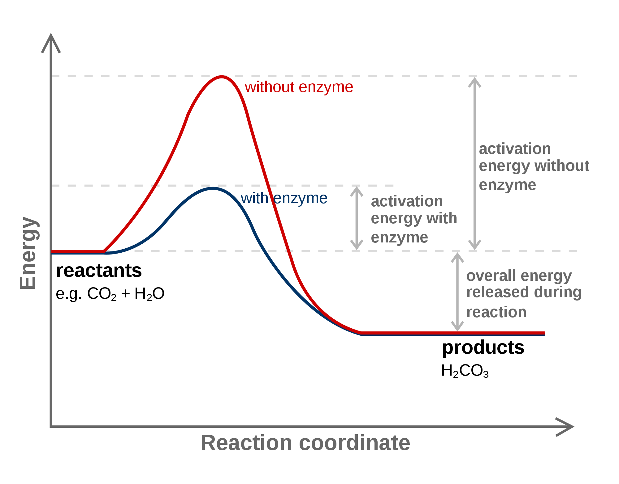
ENZYMES
Some chemical reactions are too slow or have too high an activation energy
Activation energy: energy needed to start a reaction
Catalyst: substance that speeds up the rate of the reaction by lowering activation energy required
Enzymes: proteins that are catalysts- speed up chemical reactions by lowering activation energy

Slide 8
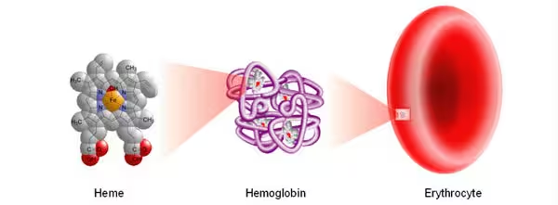
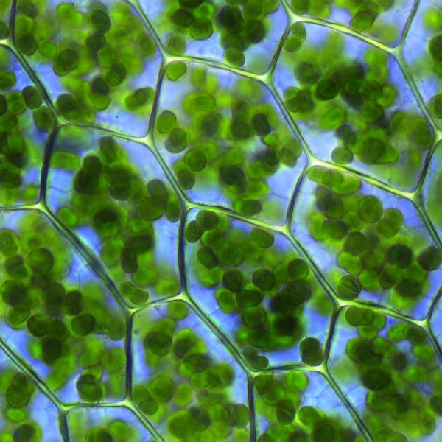
A study done by the UNC school of Medicine concluded that the synthesis of hemoglobin and chlorophyll would take approximately 2.3 BILLION years without the presence of an enzyme.

Slide 9
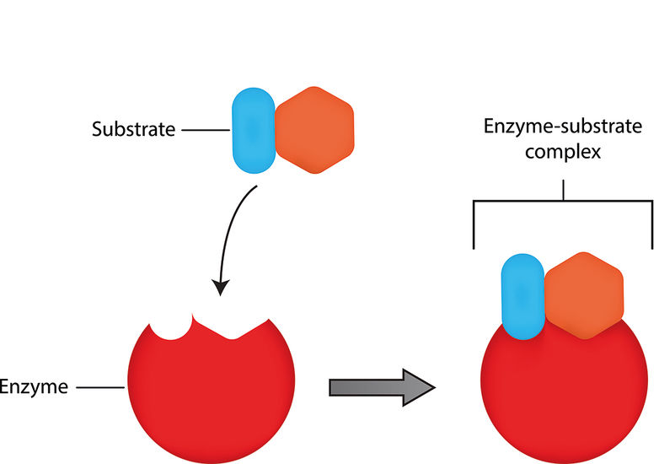
ENZYME SUBSTRATE COMPLEX
Substrate: reactants
Active site: place where the substrates bind to the enzyme
Enzyme + bonded substrates= Enzyme substrate complex

Slide 10
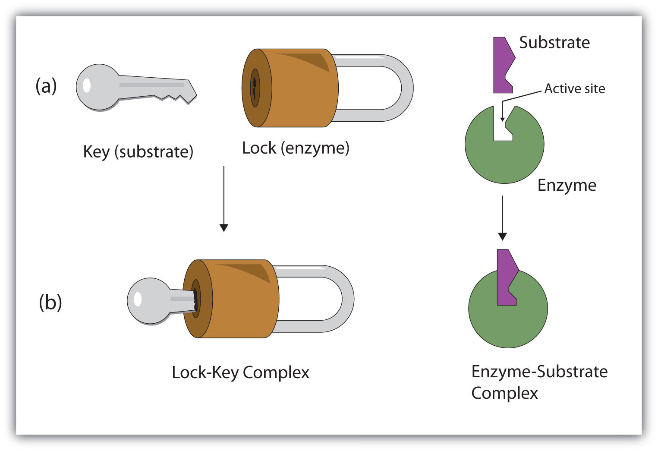
LOCK AND KEY MECHANISM
Enzymes can only bind to certain substrates based on their shape
When the reaction is over, the enzyme is left as it was
  Enzymes are NOT permanently changed or used up

Slide 11
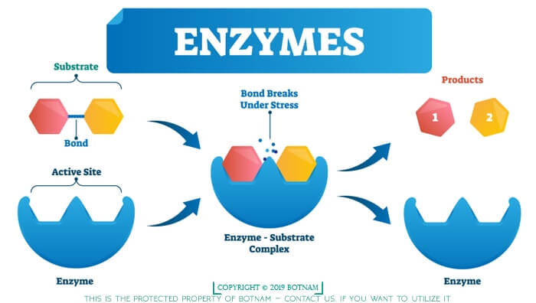
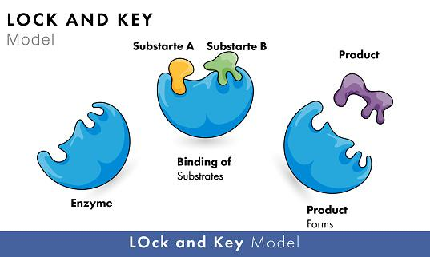
ENZYMES CAN CATALYZE CATABOLIC OR ANABOLIC REACTIONS
Catabolic 🡪
-Breakdown
-Release energy
Anabolic 🡪
-Build up
-Store energy

Slide 12
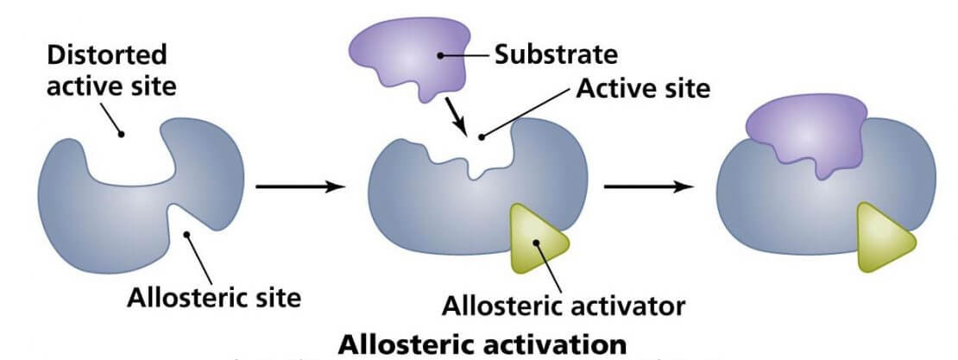
ALLOSTERIC ACTIVATION
Allosteric enzymes will have an allosteric (secondary) site necessary for binding
Effector molecules bind to this site and modify the shape of the enzyme to allow the substrate to bind

Slide 13
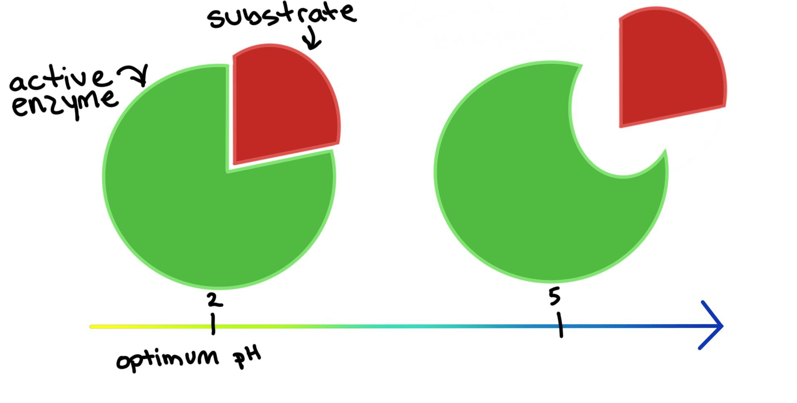
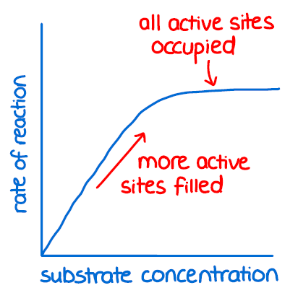
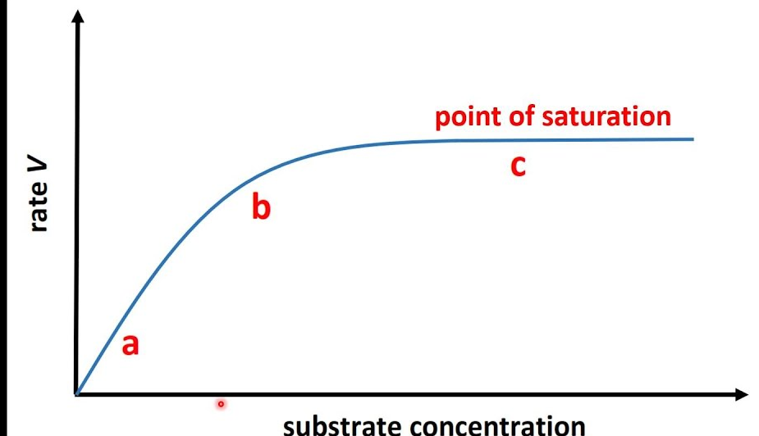
CHANGES TO ENZYME ACTIVITY
Some factors may affect the enzyme’s ability to function by changing the shape of the enzyme
Enzymes are sensitive to changes in temperature and pH
Too much change results in denaturation- destruction of protein structure
Amount of substrate available will also affect how active an enzyme is* →
*Increasing substrate concentration increases the rate of reaction to a point. At some point the enzyme is considered “saturated” with substrate and the reaction rate will plateau.

Slide 14
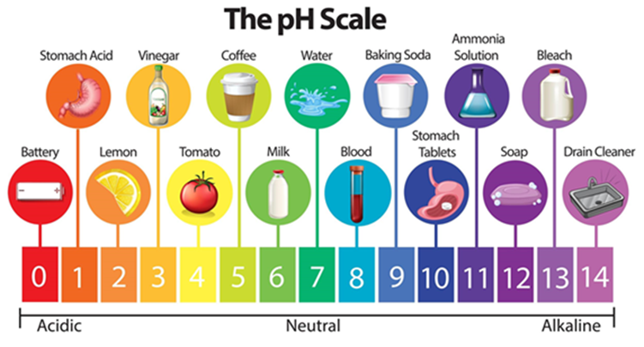
The pH scale
Used to rank solutions in terms of acidity or alkalinity (how basic it is)
Measures concentration of H+ ions
MOST solutions fall on this scale but it is possible for solutions to be less than zero or more than 14
Most cells exist within a pH of 7 and exposure to more acidic or basic conditions can cause denaturation of proteins

Slide 15
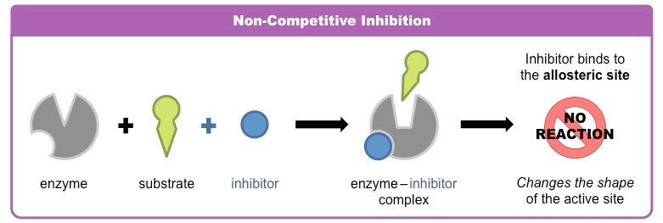
NON-COMPETITIVE INHIBITION
An inhibitor molecule changes the shape of the enzyme by binding to the allosteric site
Substrate is unable to bind due to shape change

Slide 16
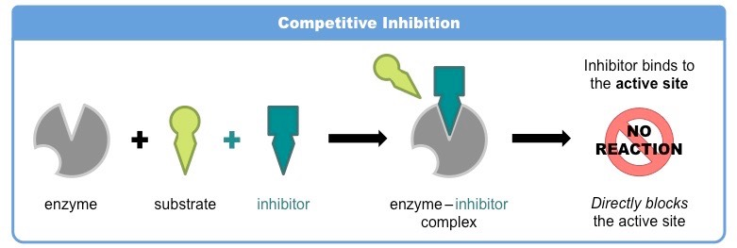
COMPETITIVE INHIBITION
An inhibitor molecule binds to the active site and prevents the substrate from binding at all → directly blocking the active site

Slide 17
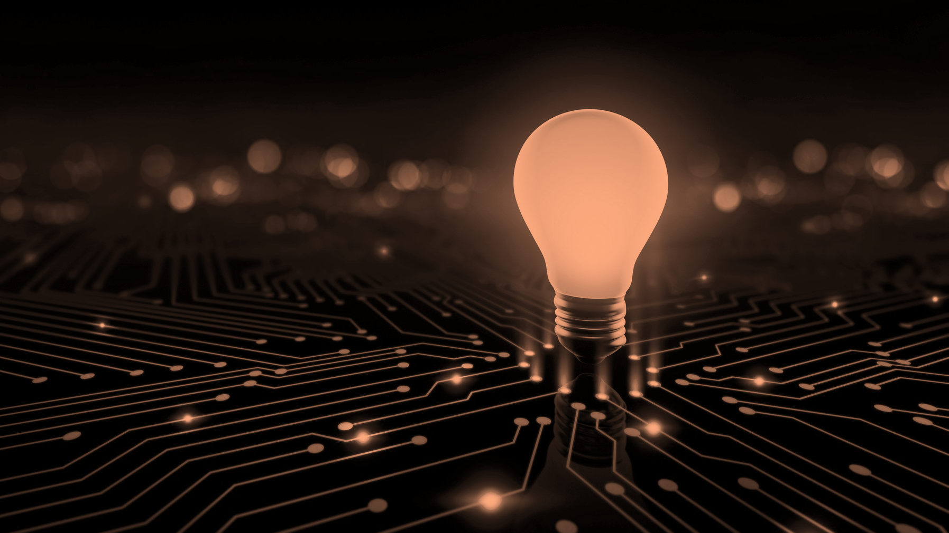
ATP AND ENERGY

Slide 18
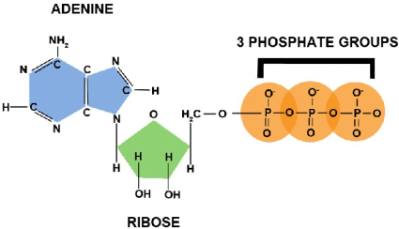
ATP
Adenosine Triphosphate= cell’s energy shuttle
Composed of:
  A ribose sugar
  Adenine
  3 phosphate groups

Slide 19
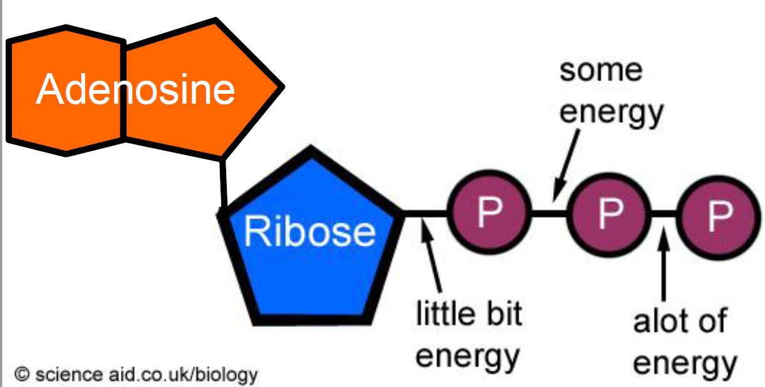
ENERGY FOR THE CELL
ATP is chemical fuel that powers the activities of the cell.
Energy is stored in the phosphate bonds
**Most energy in the bond between the second and third phosphate
Notes:
Play amoeba sisters at 3:01 on ATP

Slide 20
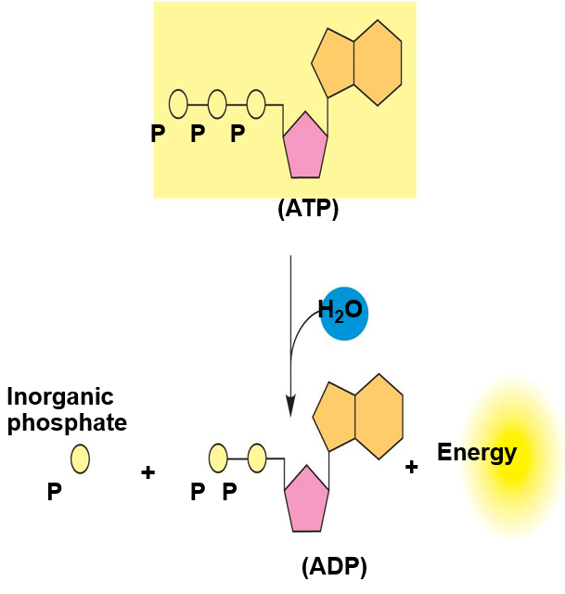
ATP HYDROLYSIS
Bonds between the last two phosphate groups in the tail of ATP are broken
Energy is released as a result

Slide 21
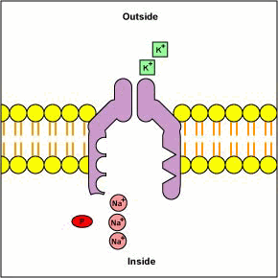
WHAT HAPPENS TO THE PHOSPHATE GROUP?
ATP hydrolysis helps to drive reactions by phosphorylation:
  Transferring a phosphate group to some other molecule such as a reactant
The recipient molecule is now phosphorylated 🡪 receives energy

Slide 22
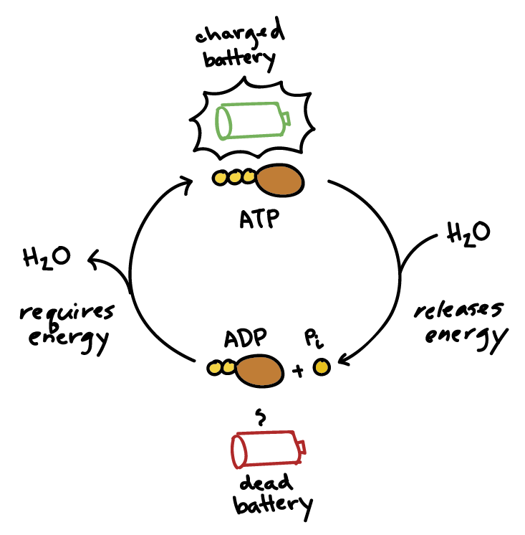
ATP ADP CYCLE
ATP is renewable and regenerated by the addition of a phosphate group to adenosine diphosphate
The energy to phosphorylate ADP comes from catabolic reactions in the cell
Chemical energy stored in ATP is what powers most cellular work

Slide 23
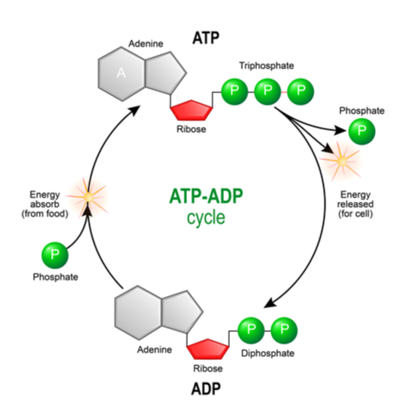
ATP-ADP CYCLE

Slide 24
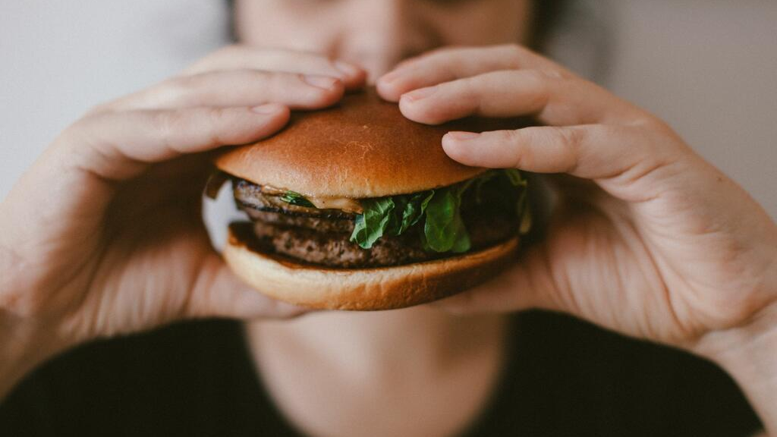
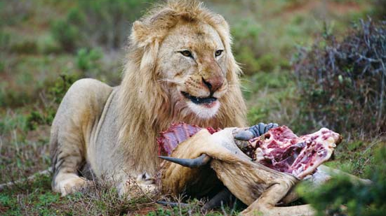
HARVESTING STORED ENERGY
Energy is stored in organic molecules
Heterotrophs eat organic molecules and digest them for:
  Raw materials for synthesis
  Fuels for energy

Slide 25
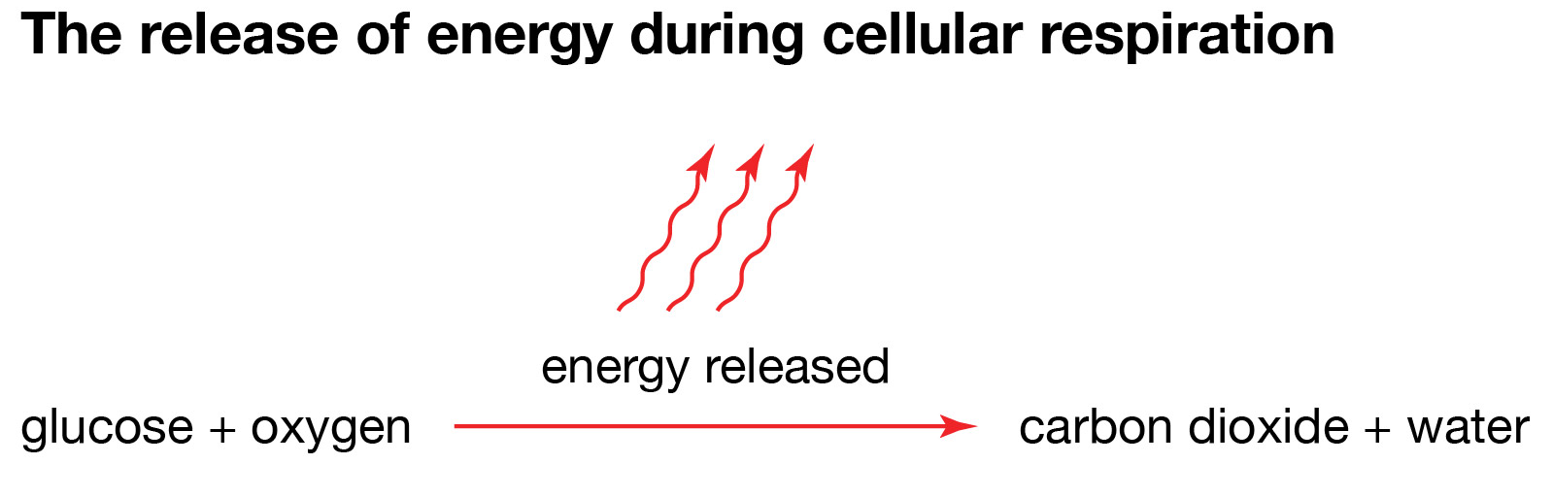
HARVESTING STORED ENERGY
We use catabolism of glucose as the model
Respiration: making ATP (& some heat by burning fuels in many small steps)

Slide 26
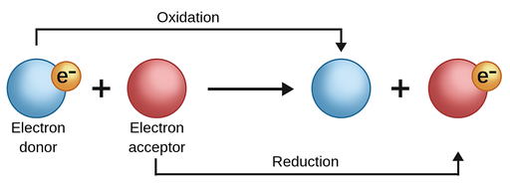
HOW DO WE HARVEST ENERGY FROM FUELS?
Digest large molecules into smaller ones
  Break bonds and move electrons and hydrogens from one molecule to another
  As electrons move they carry energy 🡪 this can be stored in another bond

Slide 27
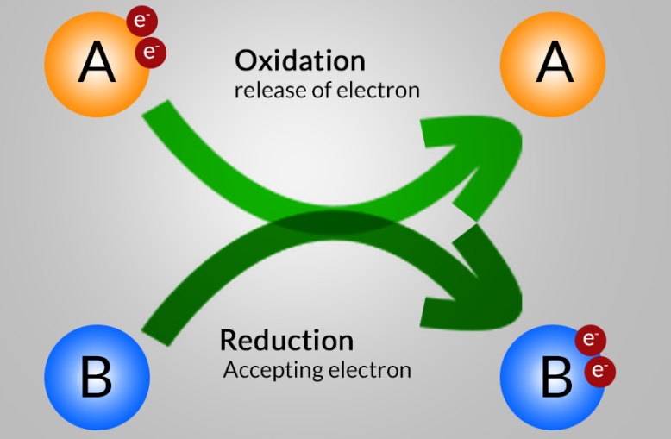
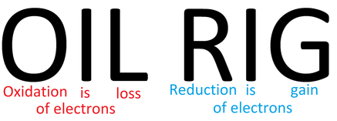
OXIDATION AND REDUCTION
Oxidation: Electrons and hydrogen are lost
Reduction: Electrons and hydrogens are gained 🡪 energy is stored

